Slide 1

Remotely Operated Vehicle (ROV)
Iqmal Hakimi Bin Razali
1912103

Slide 2
History of rov
The Marine Technological Society's Remotely Operated Vehicle Committee states that while it's unclear who exactly is to credit for creating the first ROV, two people are deserving of recognition. The PUV (Programmed Underwater Vehicle) was a torpedo created by Luppis-Whitehead Automotive in Austria in 1864, but Dimitri Rebikoff created the first tethered ROV in 1953 under the name POODLE.
The U.S. Navy started developing robots to help find and retrieve undersea ordnance in the late 1960s. Commercial businesses started using the technology to help the oil and gas sector in the 1980s. Nowadays, ROVs are utilized for a wide range of exploratory and business purposes, including evidence collection, pipeline maintenance, aquaculture, and drowning victim recovery, in addition to dam and water tank inspections.
ROVs can now be classified as Science-Class or Working-Class vehicles depending on whether they are employed for industrial surveillance or ocean exploration.

Slide 3
Applications
Offshore Energy
General Visual Inspection
Close Visual Inspections
NDT Inspections
Infrastructure Deployment and Recovery
Control Manifold Interventions
Military
Submarine Rescue
Waterborne Improvised Explosive Device (WIED) Intervention
Sea and Limpet Mine Intervention
Special Recovery
Naval Asset Inspections
Hydrography
Oceanography and Marine Science
Coral and Marine Life Observation
Sample and Sediment Collection
Academic Research Applications
Inshore Infrastructure
Condition Assessment and Monitoring
Sediment Sampling
Removal of Sludge by Dredging
Debris Collection
Search and Rescue
Drowned Victim Recovery
Forensic Assessment
Equipment Recovery
Large Scale Search and Documentation
Commercial Diving and Salvage
Attaching and releasing hooks for equipment installation and recovery
Construction and salvage
Aquaculture
Equipment and infrastructure monitoring
Rope management and recovery
Net Repair
Mort Retrieval
Nuclear Decommissioning
Fuel Rod Management
Debris Collection and Removal
General Visual Inspection
Cutting and Recovery
NDT Inspections

Slide 4
Main Components of ROV
Hull Design
Propulsion System
Navigation System & Control
Data Collection
Data Transmission
Power Management

Slide 5
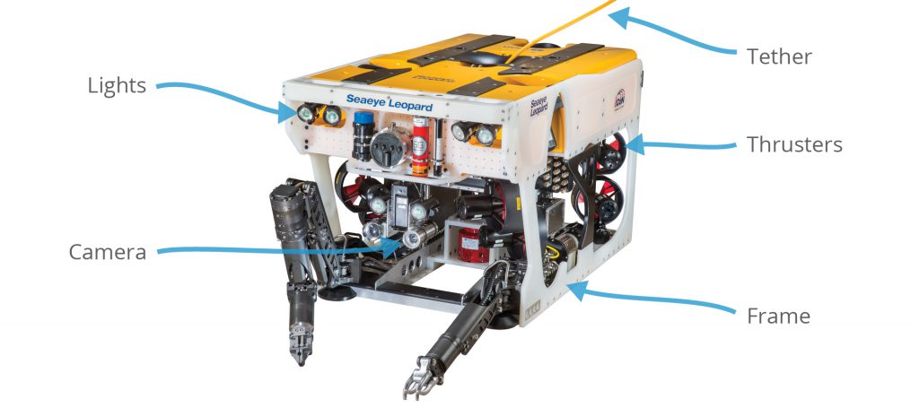
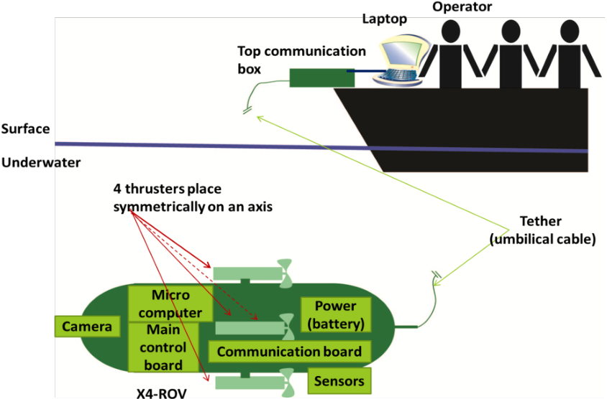
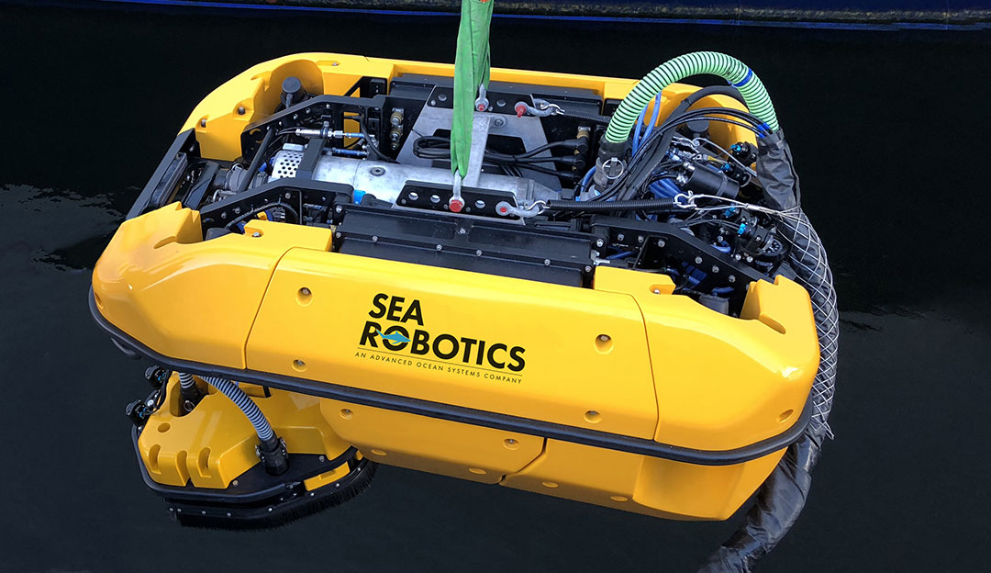
Hull Design

Slide 6
Propulsion System
A method of locomotion is a requirement for every mobile robotic system in order to move the robot. Because of this, thrusters are utilized to maneuver the ROV.
Each ROV system's thrusters must be carefully considered during design. If the ROV doesn't have enough thrust, the environment may overwhelm it and prevent it from carrying out the required activities.
Electrical, hydraulic, ducted jet, or a combination of the three can all be used as thrusters.

Slide 7
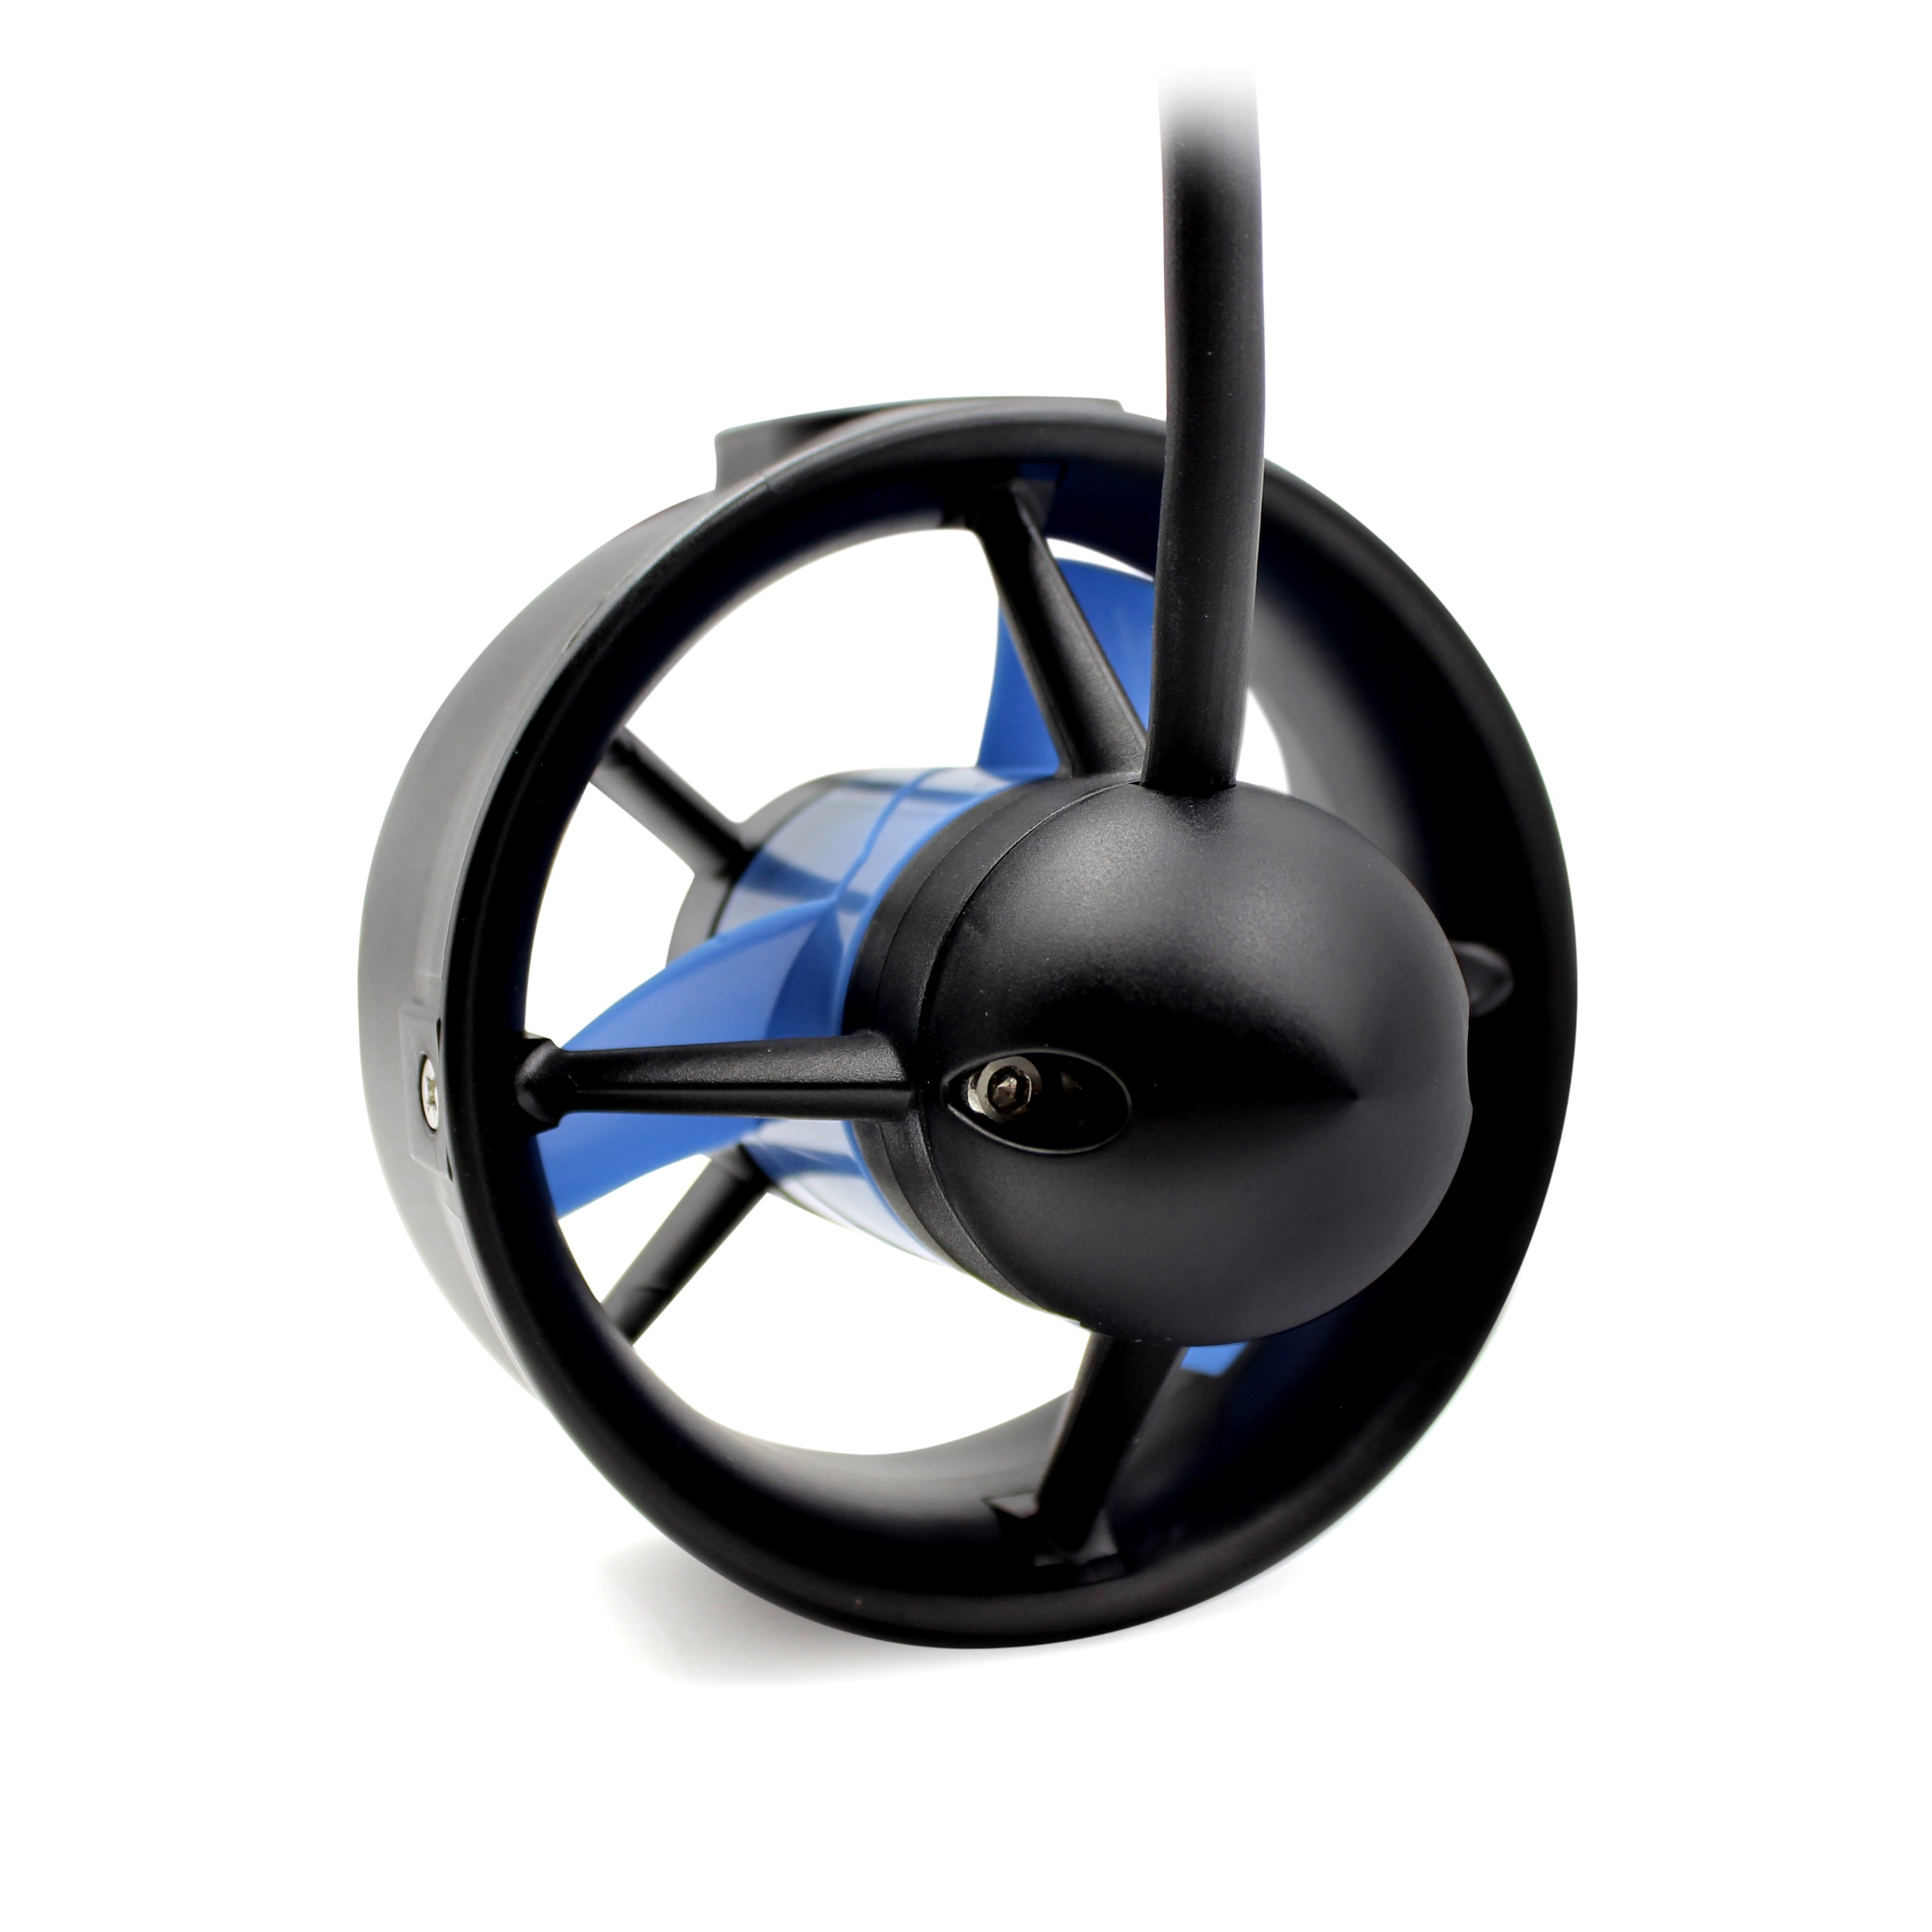
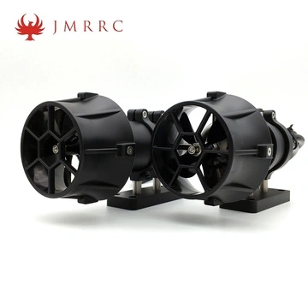
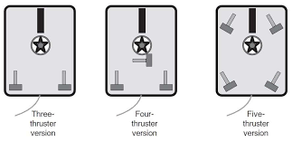
Propulsion System

Slide 8
Navigation System & Control
Camera
A pilot's knowledge of their surroundings serves as the foundation of positional awareness. With a data tether, ROVs may transmit real-time 4K video feeds to the operator on the surface.
Inertial Measurement Unit (IMU)
A three-axis gyroscope, a compass, and a three-axis accelerometer are all found on a sensor chip known as an IMU. They are present in all smart gadgets, including smartphones, virtual reality headsets, and robotic arms. This data will be combined by an internal algorithm to get a best estimate of direction in three dimensions.
Depth Sensor
The ROV's depth below the surface can be determined using precisely calibrated pressure sensors. This enables autonomous depth control and navigation.
Multibeam Imaging Sonar
This technology is essentially digital echo-location and is like magic hearing with sound. To provide you with real-time video of what is in front of the ROV without using the camera, hundreds of sound beams are shot off at once. It resembles a medical ultrasound in some ways, but it is considerably simpler to read. This can be used to locate missing items on the seafloor or for navigation by identifying underwater landmarks. Even small structures can be inspected by the high frequency multibeam with an amazing millimeter resolution.

Slide 9
Navigation System & control
Ultra Short Baseline (USBL) aka underwater GPS
A surface beacon receives a ping from a sonar beacon mounted on the ROV, and the position of the surface beacon is triangulated using transducers millimeters apart. The term "Ultra-Short Baseline" refers to the millimeter baselines (distances between the triangulation locations). GPS data is linked with the ROV's location in relation to the topside beacon to provide the ROV's current latitude and longitude.
Doppler Velocity Log (DVL)
This sensor makes use of sonar transducers that are pointed in four directions towards the ocean below and function like police speed guns. Using the Doppler Effect, it determines the ROV's velocity and speed by measuring the change in frequency (pitch). It can also determine the altitude above the bottom and the reaction time of these sonar pings. This can help with autonomous depth holding and USBL data quality. The most intriguing application for this data is autonomous position hold, which paves the door for full autopilot and enables the ROV to battle currents without the need for human involvement.

Slide 10
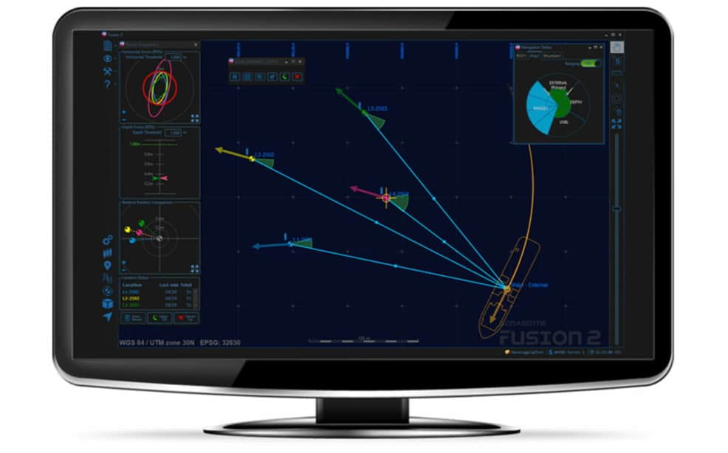
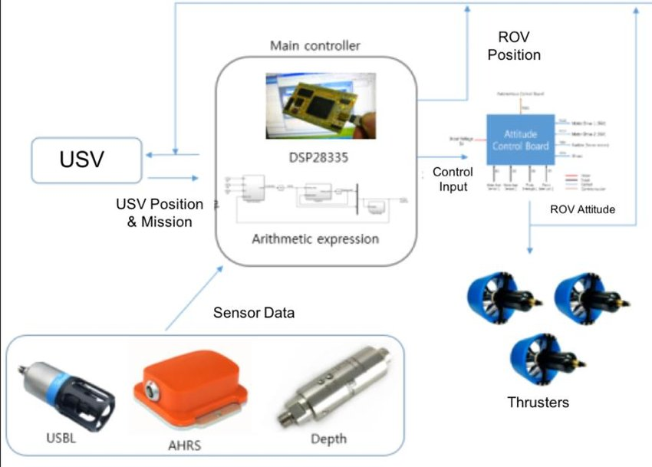
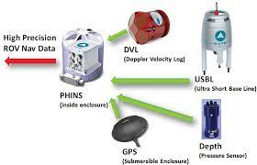
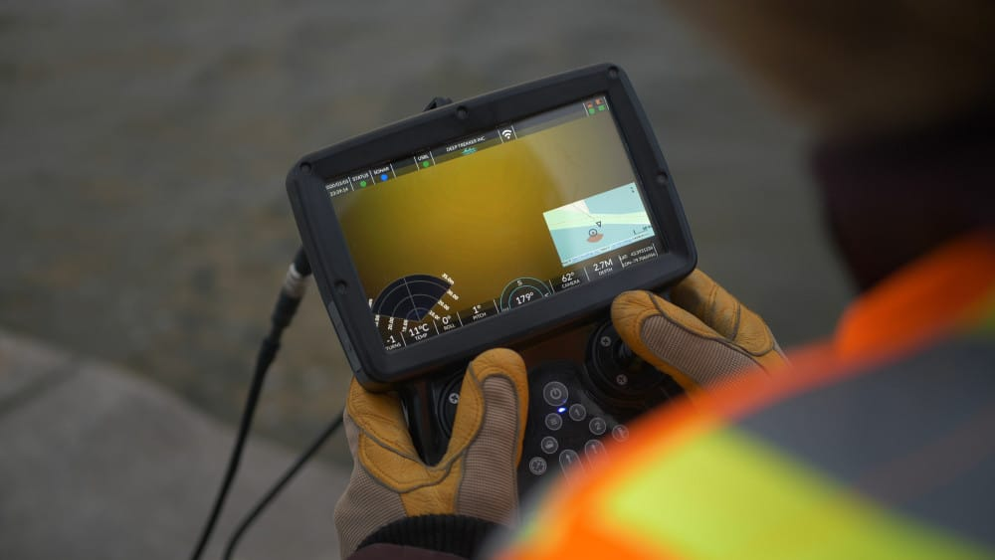
Navigation System & Control

Slide 11
Data Collection
In addition to lights, sonar equipment, and a buoyancy foam pack that keeps the ROV light and manoeuvrable in the water, standard ROV components include video cameras that send real-time surveillance to scientists aboard the surface vessel.
Measurements of conductivity, temperature, and depth can be made by ROVs using external sensors mounted on the craft.
A manipulator arm is frequently included into ROVs to gather biological and geological samples, which are then placed in boxes along the edges of the ROVs.
Pilots on the surface vessel use joysticks and touchscreens on a "control box" to direct the movement of the ROV and its manipulator arms.

Slide 12
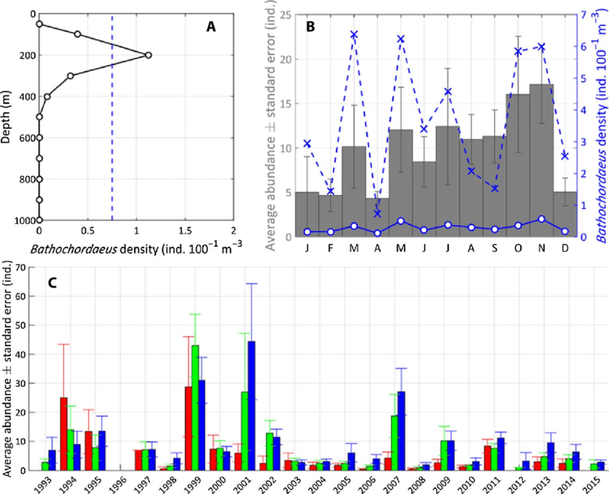
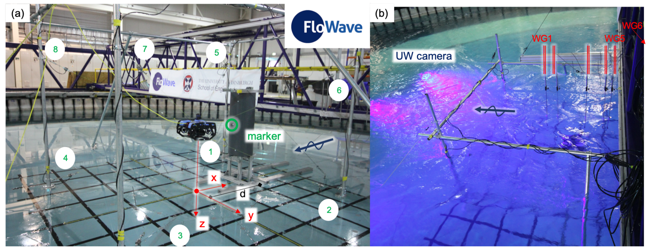
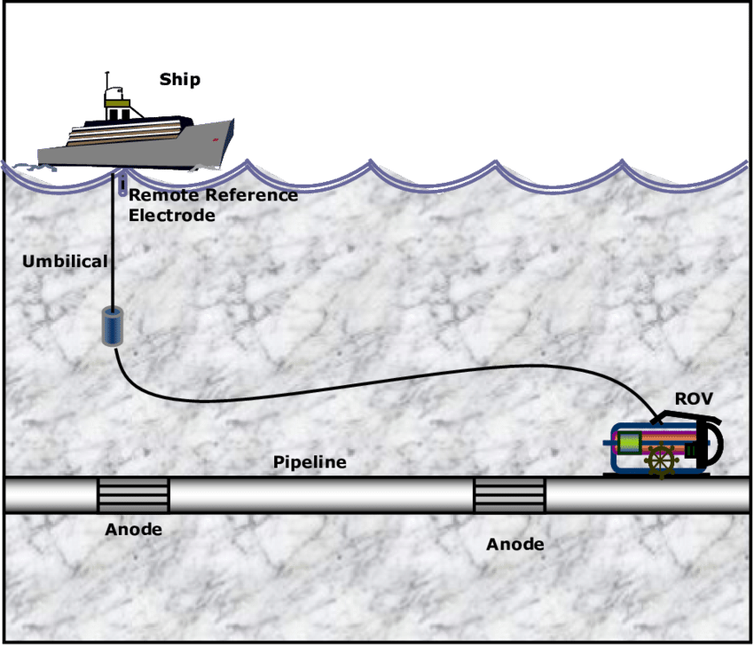
Data Collection

Slide 13
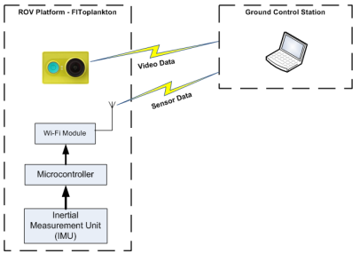
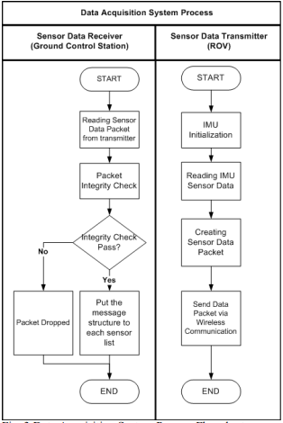
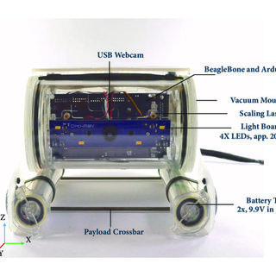
Data Transmission

Slide 14
Data Transmission
It is possible to use 2.4 GHz Wifi Communication for transmitting sensor data for underwater applications on very shallow water (< 20 cm depth). This method can be used for underwater monitoring by combining the advantage of electromagnetic and acoustic communications.
Some manufacturers have modified TCP/IP, RS-485, and other industry-standard protocols for such transfers. Although beneficial and seemingly commonplace in the computer industry, the most used protocol, RS-232, is distance limited by conductors, which causes transmission issues over extended lengths of tether.

Slide 15
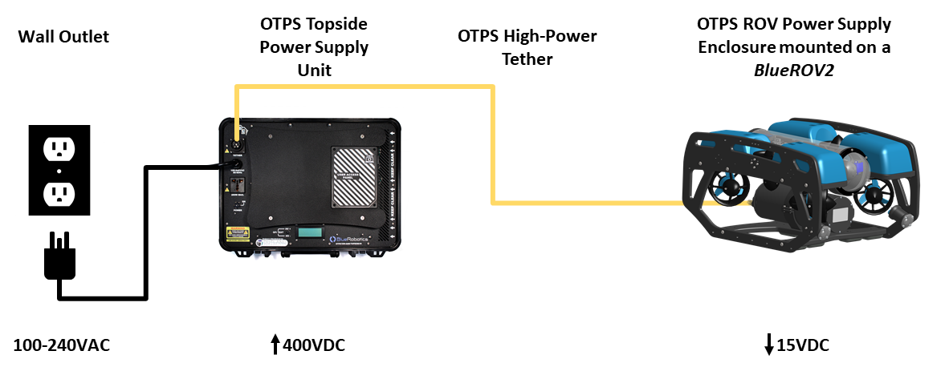
Power Management

